Slide 1
Real Estate Market Analysis
(Gurgaon)

Slide 2
Business Background
The real estate advisory firm operates in Gurgaon, one of the fastest-growing residential markets in India.
The firm has invested significant time and effort in collecting structured data on residential property listings across multiple sectors.
The objective is to provide data-driven insights to:
Home buyers seeking safe and value-driven investments.
Investors looking for stable and high-return opportunities.
Developers planning future residential projects Given the dynamic pricing structure, varying property types, and regulatory factors such as RERA approval, a structured analytical approach is required to guide informed real estate decisions.
Gurgaon Real Estate Dataset of 2024

Slide 3
Business Questions
Which locality has the highest average price?
Which locality has the highest rate per square foot?
Which builder sells most expensive properties?
Does approval status increase property value?
Which flat type is most demanded?
How does area impact price?
Is there a statistically meaningful relationship between BHK configuration and property price?

Slide 4
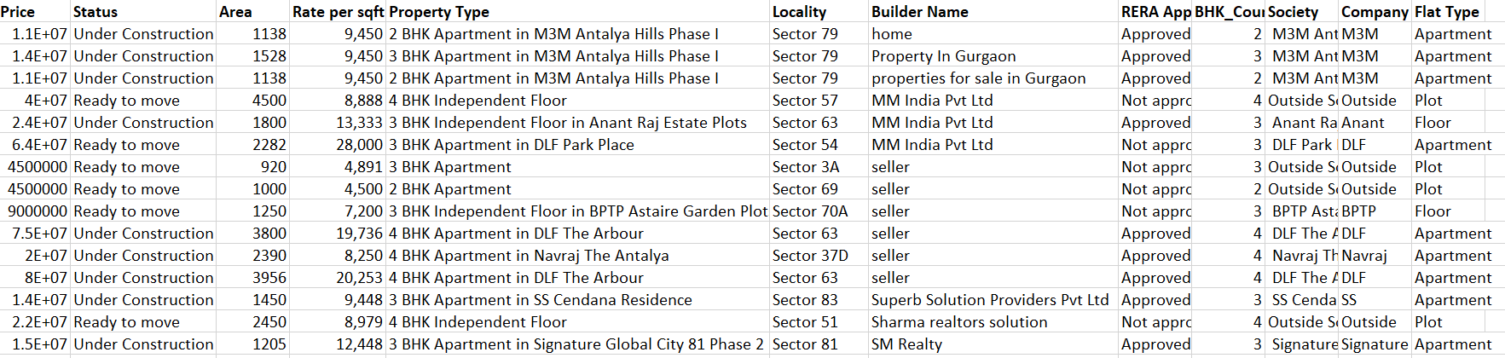
Data Overview
The dataset contains 19,516 records of real estate properties.
Main columns in the dataset include:
Price
Status of property
Area
Rate per square feet
Property type
Locality name
RERA approval status
BHK count
Builder name
Society
company
flat type

Slide 5
Solution Overview
We will solve this problem using Exploratory Data Analysis (EDA). EDA helps us understand patterns, relationships, and anomalies in the data before applying any advanced modelling.
The solution is divided into logical steps:
Data loading and understanding.
Data cleaning and preparation.
Analysis to answer each business question.
Summary of insights.

Slide 6
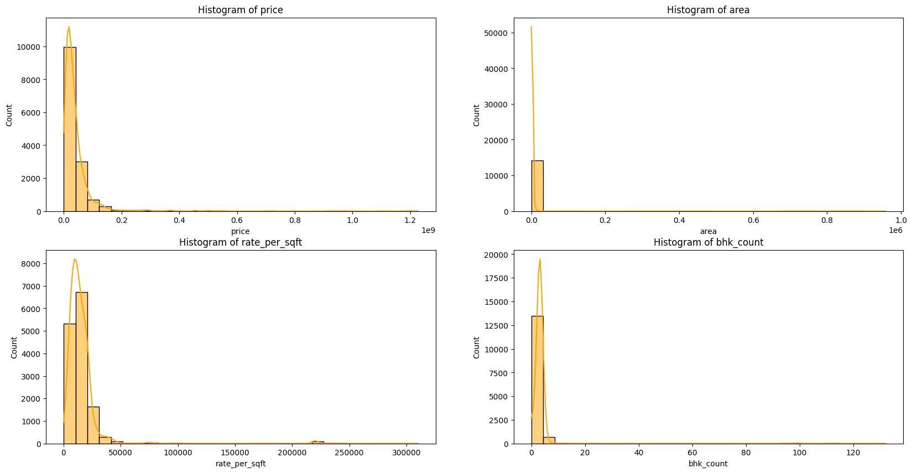
Outlier Analysis
Real estate data naturally contains outliers due to multiple property types in Gurgaon.
The dataset includes various property categories such as villas and independent houses, which can show price variation.
Since outlier values were low, they were retained and will not highly impact the analysis results.
Percentage of outliers in price: 6.78%
Percentage of outliers in area: 6.72%
Percentage of outliers in rate_per_sqft: 3.35%
Percentage of outliers in bhk_count: 0.50%

Slide 7
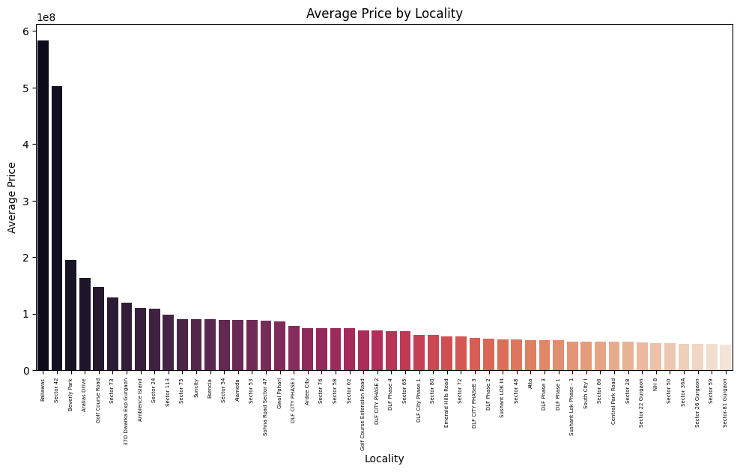
Answer to the Questions
Which locality has the highest average price?
The analysis shows that property price mainly depends on the locality .

Slide 8
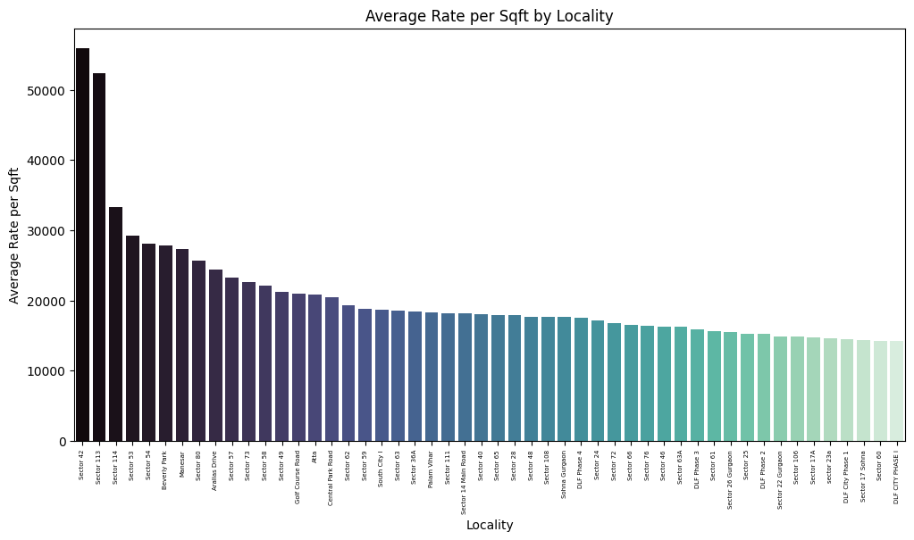
Which locality has the highest rate per square foot?

Slide 9
Which builder sells most expensive properties?
builder_name
Harish 221100000.0
India Gold Properties 203837500.0
Bob vennikal 185000000.0
Vinit tomar 183585000.0
Arihant prime realtors 180000000.0
Dream Home Realty 173337500.0
AMAYA Landbase 168250000.0
Jagdish Estate 154100000.0
GharDekhoCo 150783333.333333
JP Groups 150000000

Slide 10
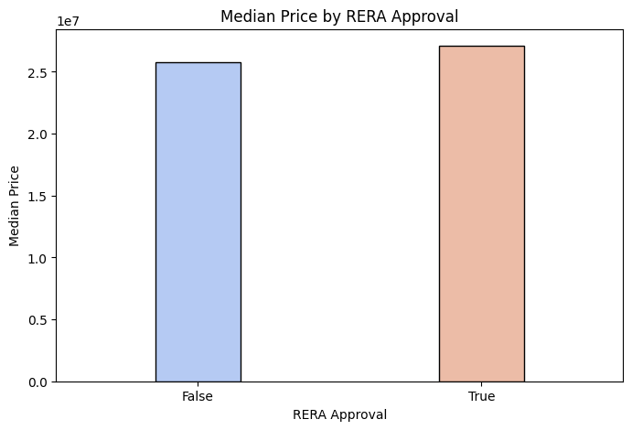
Does approval status increase property value?
rera_approval
False 25800000.0
True 27100000.0
The analysis indicates that RERA-approved properties have a higher median price compared to non-approved properties. This suggests that buyers may be willing to pay a premium for regulatory compliance and legal security.

Slide 11
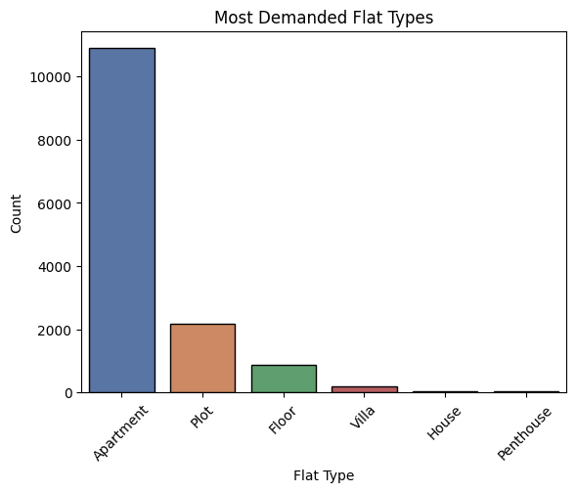
Which flat type is most demanded?
Apartment 10894
Plot 2166
Floor 881
Villa 205
House 45
Penthouse 32
Apartments represent a relatively safe investment segment due to high buyer demand and strong market liquidity.
Houses and penthouses fall under niche luxury segments with a limited buyer base.
Properties in these segments may take longer to sell due to lower demand.
For short-term investors, houses and penthouses may involve higher liquidity risk.
However, these luxury segments may still offer attractive returns for long-term investors targeting premium buyers.

Slide 12
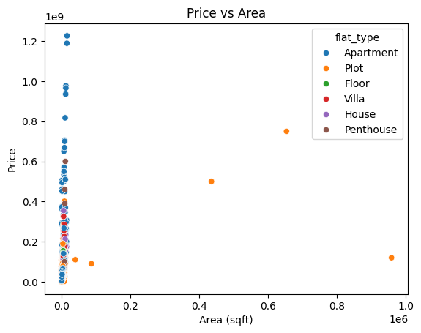
How does area impact price?
Scatter plot suggest that property price is not strongly dependent on area.

Slide 13
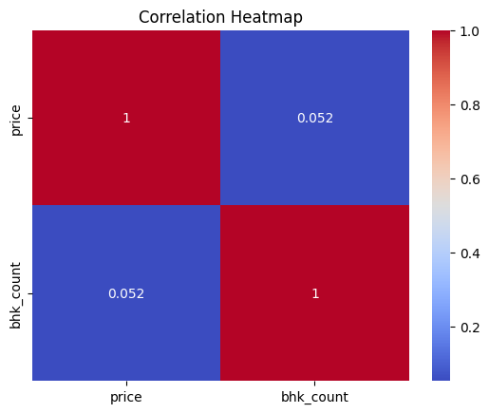
Is there a statistically meaningful relationship between BHK configuration and property price?
Increasing the number of BHK does not significantly affect the property price.

Slide 14
Executive Summary
Premium Localities consistently show higher prices
rera -approval properties trend to command higher prices
larger homes are not always more expensive per sqft
Apartment generally higher in demands.
Increasing the number of bhk not affect the price.

Slide 15
Strategic Recommendations
The analysis reveals that property prices are mainly influenced by premium localities rather than property size. Approved properties are trending in the market as they generally have higher prices. Larger properties are not always more expensive per square feet, and the number of bedrooms (BHK) does not significantly impact price. Apartments show the highest demand compared to other property types such as villas and penthouses. Therefore, investors should focus more on high-demand localities and apartment segments for better market opportunities.

